Slide 1


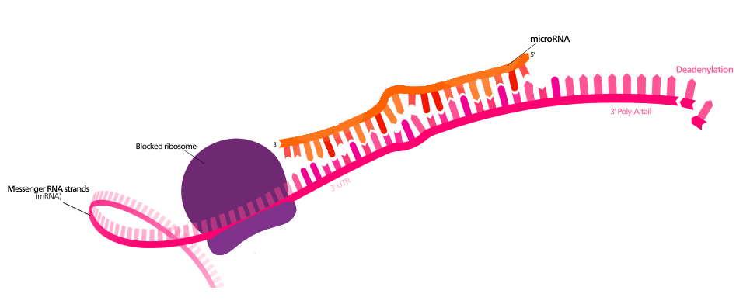
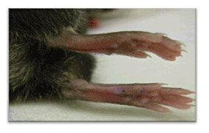
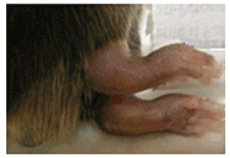
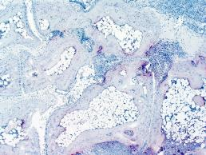
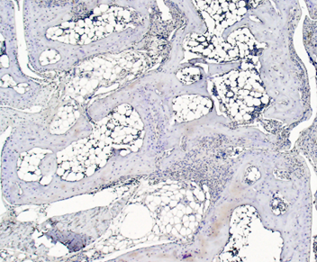
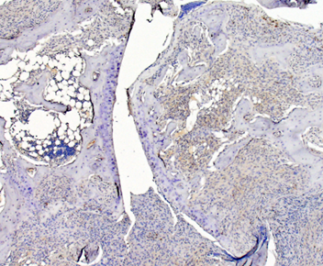
The role of microRNA-146a in inflammatory Arthritis
DIVISION OF
RHEUMATOLOGY
Saferding Victoria¹, Puchner Antonia¹, Goncalves Alves Eliana¹, Melanie Hofmann¹, Sahin Emine², Silvia Hayer¹, Smolen Joseph S.¹, Redlich Kurt¹, Blüml Stephan¹
¹Medizinische Universität Wien Innere Medizin III, ²Medizinische Universität Wien Institut für Physiologie
Background:
MicroRNA (MiR-) 146a is a key regulator of the innate immune response and has also been shown to suppress cancer development in myeloid cells. Elevated expression of miR-146a has been detected in synovial tissue of rheumatoid arthritis patients, but its role in the development of inflammatory arthritis is yet unknown.
miR-146a
IRAK1
TRAF6
NF-κB
Survival
Proliferation
Inflammation
miRNA
miR-146a level in arthritis
disease models
Healthy
Arthritic
mRNA
A
SP
BM
Paw
SP
BM
Paw
Serum-transfer arthritis
Relative miR-146a
expression
Relative miR-146a
expression
hTNFtg
A, miR-146a levels in spleen, bone marrow and paw from K/BxN serum-transfer (day 1, 2, 3 and 10) and hTNFtg arthritis (week 6,8 and10) diseased mice, measured by Q-PCR.
K/BxN serum-transfer arthritis
B
Grip strength
10
Paw swelling
C
1,500
IL-12p40
40
IL-6
8
*
wt
1,000
**
30
6
*
miR-146a^{-/-}
IL-12p40 pg/ml
IL-6 pg/ml
Clinical score
Clinical score
20
4
500
10
2
0
0
3
6
9
12
15
0
0
B, Clinical assessment of grip strength and paw swelling over 12 days
after induction of serum-transfer arthritis in wt and miR-146a^{-/-} mice.
C, Serum Cytokine levels after the induction of serum-transfer arthritis in wt and
miR-146a^{-/-} mice, measured by Elisa.
hTNF-alpha transgenic mouse model of inflammatory arthritis
D
hTNFtg
hTNFtg miR-146a^{-/-}
E
400
IL-1β
100
IRAK1
15
TRAF6
pg/ml
300
TNFtg
80
*
60
10
expression
expression
Relative TRAF6
β
200
*
Relative IRAK1
hTNFtg
IL-1
100
40
5
hTNFtg/
miR-146a^{-/-}
0
20
)
IL-1β
0
RANKL
0
OPG
2
1.5
)
0.4
100
**
3
*
TNFtg miR-146a^{-/-}
50
*
8
**
2
0.3
**
80
2
40
6
1
60
30
expression
expression
Relative OPG
Area of
Area of
Number of OC
Semiquantitative scoring
Relative RANKL
4
inflammation (mm
erosion (mm
0.5
0.2
40
1
20
2
*
0.1
20
0
10
0
0
0
0
D, Histological assessment of inflammation, erosion and number of osteoclasts (OC) in the
tarsal area of the hind paws from 10 weeks old hTNFtg and hTNFtg/miR-146a^{-/-}mice. Images of the TRAP stained tarsal area of the hind paws from TNFtg and hTNFtg/miR-146a^{-/-}mice.
E, Serum Cytokine level of IL-1β from 10 weeks old hTNFtg and hTNFtg/miR-146a^{-/-}mice measured by Elisa and immunohistological analysis of IL-1β in the hind paws of hTNFtg and hTNFtg/miR-146a^{-/-}mice. MRNA expression level of the indicated genes in the joints of hTNFtg and hTNFtg/miR-146a^{-/-}mice.
Conclusion:
These data clearly demonstrate a negative regulatory role of the miR-146a in inflammatory arthritis. During arthritis, miR-146a is centrally involved in the regulation of proinflammatory cytokines as well as local bone destruction. These results identify an important anti-inflammatory role of miR-146a, which might possibly be exploited for therapeutic purposes.

